Slide 1
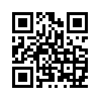
Tax law in the era of digitalization
Kolesnikov Yuriy
Doctor of Law, Professor,
head of the Department of financial law of Southern Federal University
Warsaw
2021

Slide 2
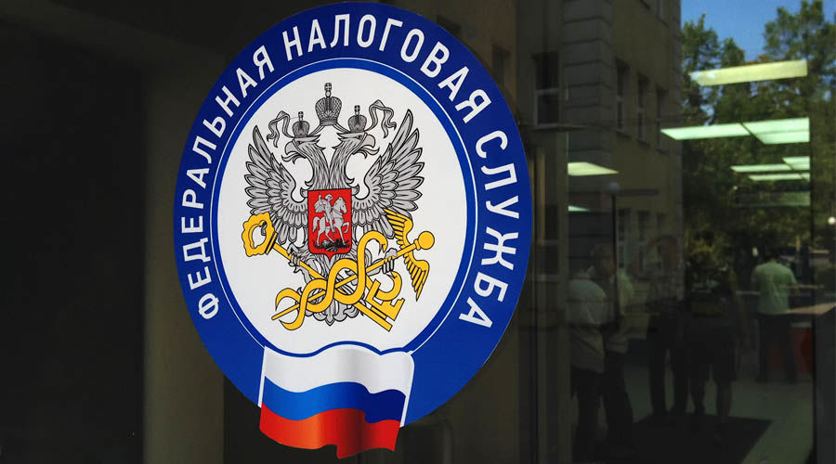
«AI is a human-developed system consisting of software and, in some cases, hardware, operating in the physical or electronic world, which analyzes the surrounding reality by collecting data, analyzing it, drawing conclusions from existing knowledge or processing information based on the collected data, and making decisions about the optimal actions to be taken to achieve the goal» (from the European Commission study)
Forms and methods of tax control (Article 82 of the Tax Code of the Russian Federation):
tax audit;
getting explanations;
checking accounting and reporting data;
inspection of premises and territories used for profit-making;
other control procedures provided for by the Tax Code of the Russian Federation.

Slide 3
Powers of tax control bodies
Country | Russia | Ukraine | Belarus
Tax authority | Federal Tax Service of Russia (FTS) | The state fiscal service of Ukraine (SFS) is the Central body of Executive power, whose work is directed by the Minister of Finance and which implements the state's tax policy, the state policy in the sphere of the state customs Affairs public policy, administration of the single contribution for obligatory state social insurance (further - the single payment) public policy in the sphere of combating crime in the application of tax, customs legislation as well as legislation concerning payment of single contribution. | Ministry of Taxes and Duties of the Republic of Belarus
Credentials | control and supervision of compliance with the legislation on taxes and fees, the correctness of calculation, completeness and timeliness of payment of taxes, fees and other mandatory payments; control and supervision of the production and turnover of tobacco products; control and supervision of the application of the Tax Code; functions of the currency control body within the competence of the tax authorities. | the implementation of the state policy and tax policy in the state of customs, the state policy in the sphere of combating crime ptime ID of the application of tax, customs law, public policy, administrationof a single fee for obligatory state social insurance, state policy in the sphere of combating crime in the application of tax, customs legislation as well as legislation concerning payment of single contribution. The State Fiscal Service exercises its powers directly and through the territorial bodies established in accordance with the established procedure. The State Fiscal Service and its territorial bodies have divisions of the tax police. | implementation of control over compliance with the legislation on taxes and entrepreneurship within its competence; customs declaration of income, property and sources of funds by individuals; ensuring the correct calculation, full and timely payment of taxes, fees and other mandatory payments to the budget, state target budget and state extra-budgetary funds; control over the production and trafficking of alcohol and tobacco products; the record of calculated and paid (or recovered) in taxes to the budget; development of proposals for the improvement of tax legislation and the organization of work of tax authorities; performing the functions of a currency control agents within its competence; prevention, detection and suppression of violations of the legislation on taxes and entrepreneurship within its competence; preparation of tax agreements with other States, the implementation of ties with their tax authorities, the study of their experience; the regulations on the procedure of calculation and payment (penalty) taxes.

Slide 4
Digitalization has changed:
taxation;
tax administration;
the place and role of tax audits in the tax control system, their form, content and effectiveness.

Slide 5
Modern alternatives to tax audits:
Working groups on encouraging taxpayers to behave in good faith - the main source of budget replenishment:
saving the resources of the Federal Tax Service;
elimination of tax offenses under the "accelerated procedure".
2) Tax monitoring – tax audit is transformed from a standard tax audit into an exclusive method of tax control in relation to a certain category of taxpayers.
3) In-house inspections: there are factors that reduce their effectiveness due to the limited time and opportunities for collecting evidence.
Result 2020: reduction of the number of on-site tax audits by half compared to 2019.

Slide 6
The ratio of income from the main taxes of 2019-2020.
VAT
Personal income tax
Income tax
Mineral
extraction tax
Excise taxes
Property taxes

Slide 7
Taxes payable | Corporate income tax Corporate property tax Value added tax | Single tax paid in connection with the application of the USN |  | Unified agricultural Tax | Corporate income tax Corporate property tax Value added tax
Application Restrictions | There are no restrictions | Do not apply the Simplified Tax System to: - organizations with branches and / or representative offices; - banks; - insurers; - non-state pension funds; - investment funds; - professional participants in the securities market; - pawnshops; - organizations engaged in gambling; - organizations that are parties to production sharing agreements; As well as organizations that have: - number of employees > 100 people. - income for the year > 60 million rubles. (- cost of fixed assets > 100 million rubles. - participation of other organizations > 25%> |  | Applies to certain types of activities ! It does not apply to activities carried out under a simple partnership agreement (trust management of property).) Not applicable if the number of employees is >100. The share of participation of other organizations is not > 25%> | The ESN is applied by organizations if the share of income from the sale of their own agricultural products ? 70 %
Types of activities | No restrictions | No restrictions |  | Closed list of types of activities | Production, processing and sale of own agricultural products
Object of taxation | For corporate income tax: Profit For corporate property tax: Movable and immovable property of the organization (fixed assets) By VAT: sales of goods (works, services) | Income | Income reduced by the amount of expenses | Imputed income | Income reduced by the amount of expenses
Tax base | For corporate income tax: Monetary expression of profit For corporate property tax: Average annual cost of property Pon VAT: depends on the specifics of sales | Monetary expression of income | Monetary expression of income reduced by the amount of expenses | Amount of imputed income | Monetary expression of income reduced by the amount of expenses
Tax rate (%) | Corporate income tax: 20% For corporate property tax: no more than 2.2 % VAT: 0%; 10%; 20% | 6 % | 15 % | 15 % | 6 %

Slide 8
"The activity plan of the Federal Tax Service of Russia for 2021“
(approved by the Ministry of Finance of the Russian Federation on 19.02.2021)
strengthening cooperation with other authorities (law enforcement agencies, FSSP and customs);
industries of close attention: agriculture, cargo transportation and freight forwarding;
changing the subject of inspections: for example, in 2020, the emphasis on verification of natural persons who have foreign assets (DS, real estate, KIK) (700 thousand financial accounts 13 trillion rub.);
automation and the development of control and analytical subsystem (CAP) for the analysis of illegal tax optimization schemes (NPA);
the development of digital services (e.g., obtaining tax deductions for personal income tax in proactive mode).

Slide 9
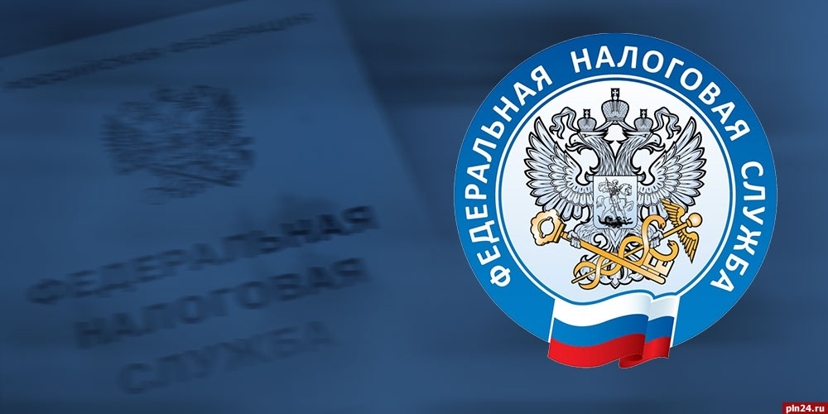
Factors influencing the development of tax law institutions:
information exchange with foreign jurisdictions;
total informatization, access to various sources of information, digital profiles, etc. The Federal Tax Service is becoming the flagship of digitalization among state bodies of Russia and tax authorities of foreign countries;
creation and development of the national system of traceability of goods (from 01.07.21, Federal Law No. 371 of 09.11.20 comes into force.);
creation of the federal register of information on the population (in the development of the provisions of Federal Law No. 168 of 08.06.20);
creation of the "USN-online" system (will allow to refuse to provide tax returns by SMEs).);
strengthening international cooperation and cooperation;
implementation of the concept of electronic document management in economic activities and the action plan;
widespread use of the USN and NAP.

Slide 10
Features of tax audits taking into account the requirements of the new Article 54.1 of the Tax Code of the Russian Federation:
The taxpayer has the right to determine the tax liability on the basis of the information reflected by him about the operations performed <...> if the following conditions are met simultaneously:
the taxpayer did not misrepresent the specified information
b) the obligations under the relevant transaction are fulfilled by a person who has entered into a contract with the taxpayer, or by a person who is obliged to fulfill the obligation by virtue of the contract or law,
c) the main purpose of the transaction or their combination was not to reduce the tax liability.

Slide 11
Commercial prudence is about experience, solvency, advertising, website, external positioning, history, letters of recommendation, founders ' experience, and the reputation of the counterparty.
It is necessary to effectively use a set of control measures, in particular the following means of proof:
questioning and obtaining explanations from persons with information about the circumstances of the conclusion and execution of transactions;
conducting inspections of territories, premises, documents, objects with the use of technical means;
comparison of the volume of goods delivered to the size of warehouses, etc.
Rate on the depth and quality of tax audits: it is clearly defined what actions should be performed by inspectors to prove that taxpayers receive an unjustified tax benefit.

Slide 12
Tax preferences in the IT sector
Countries/ | Russia | Belarus | Ukraine | Poland | Lithuania
Special mode for IT companies | - | Yes (LDPE) | - | - | Yes (for startups)
Personal income tax | 9% | 9% for HTP residents | 18% + 1.5% (military levy) Sole proprietors with USN 3% or 5% | 17-32% (+ benefit for employees under 26 years of age). Sole Proprietors: 19% (Innovation Box — 5%) | Progressive income tax rate: 20% or 32% depending on the level of annual income (up to 60 average wages paid in 2021 or higher).
VAT on the provision of IT services for export | 0% | 0% exempt if the buyer's country is recognized as the place of sale of services | 0% | 0% | 0%
Income tax | 3% | Exempt, but there is a fee of 1% of revenue | 18% | 19%Provided for: - R & D benefits -InnovationBox | Providedfor: - R & D benefits — within the FEZ

Slide 13
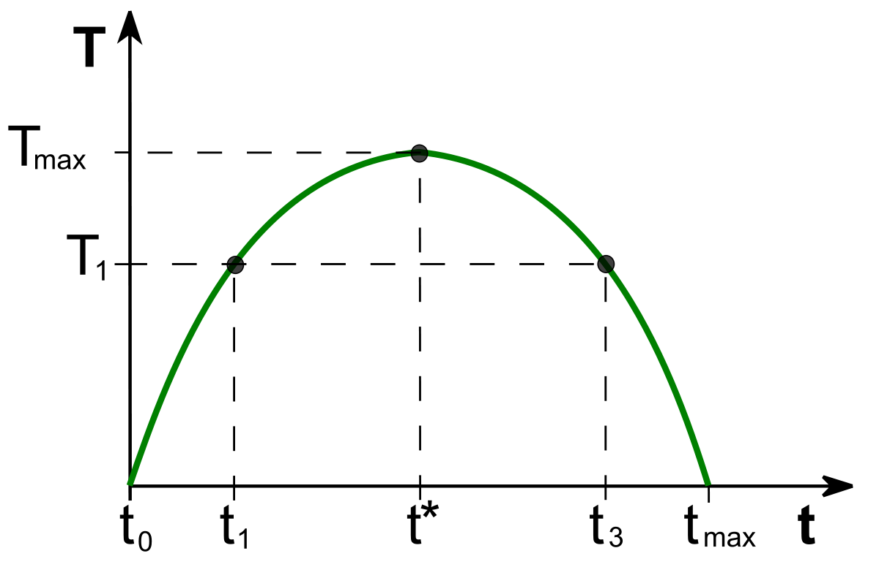
The concept of the optimal level of taxation (Laffer curve)
According to the Federal Tax Service, the volume of tax revenues to the budget has approximately tripled since 2010.The current bet on total automated tax administration processes is too risky for the state.
Slide comment: In these conditions, the consistent automation of tax administration in Russia, which leads to an increase in the real tax burden, turns out that more and more taxpayers want to go back into the shadows. However, in modern Russian realities, the Laffer curve ceases to work – it is impossible to go into the shadow, since the "shadow" as such ceases to exist: state bodies have almost complete information about payers, and the amount of cash in the economy decreases every year.As a result, not being able to go into the shadows, the business is simply forced to reduce business activity.

Slide 14
Thanks for your attention!
www.kolesnikov.pro

